Slide 1
This is a hidden slide
Dear honorable teacher please follow the instructions that has given in the slide notes (under the every slide). It would be helpful to take a successful class. Thanks a lot. I wish you good luck.

Slide 2
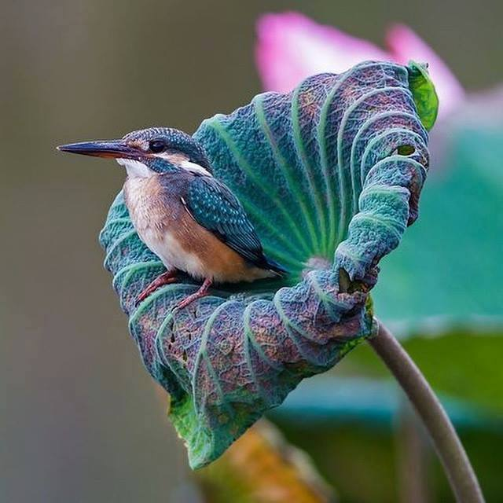
Welcome
Notes:
Teacher can say it orally.

Slide 3
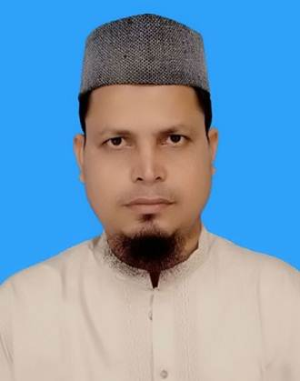
Identity
SK. Md. Harunar Rashid – SAT
Sonatola Model High School
Sonatola, Bogra.
01714622498.
Class : Six
English For Today
Lesson : 6
Notes:
Teacher can hide this slide.

Slide 4
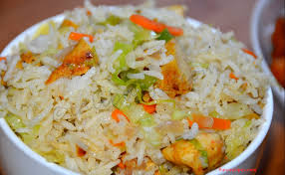
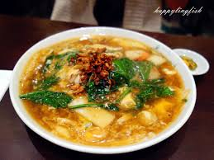
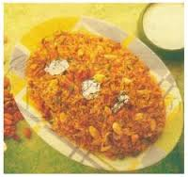
Look at the picture and guess what are they ? Do you like these dishes?
Vegetable Khichuri
Vuna
Khichuri
Moragpolau
T. What is your favorite food?
Notes:
Teacher will show the slide for eliciting the lesson declaration.

Slide 5
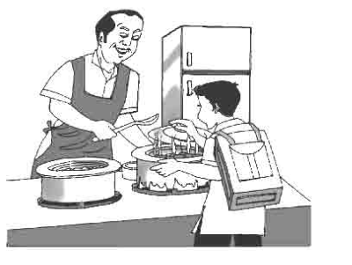
Today`s topic
It smells good !
( Lesson – 6 )

Slide 6
Learning outcomes
After completing this lesson students will be able to ..
1
Ask and answer
2
Participate in short dialogues on familiar topics
3
Fill in the gaps with appropriate verbs

Slide 7
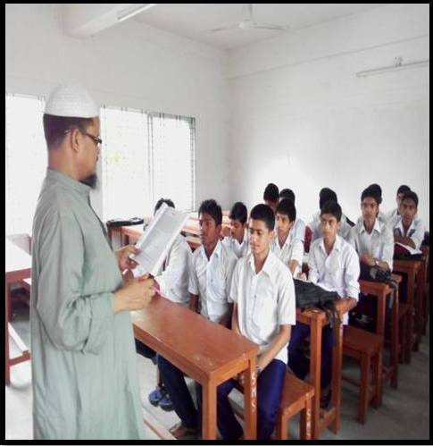
Dear Students at first listen to me attentively then answer the following questions :-
Who is cooking and what?
What is Amal`s favorite dish?
What is the meaning of smell?
What should we do before eat?
What is Amal`s mother doing ?
Notes:
Teacher will read the text, student will hear by closing book. Then they will go for writing the answer.

Slide 8
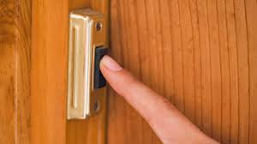
Doorbell
Key word
The doorbell is ringing
Meaning
(Click here)
Calling bell
Notes:
First, the word can be shown. The SS can be asked to pronounce the word. If it is needed teacher can help. Then the picture can be shown and asked to guess the meaning. For feedback click on meaning button.

Slide 9
Delicious
Key word
Amal`s father cooked delicious food
Meaning
(Click here)
Tasty food
Notes:
First, the word can be shown. The SS can be asked to pronounce the word. If it is needed teacher can help. Then the picture can be shown and asked to guess the meaning. For feedback click on meaning button.

Slide 10
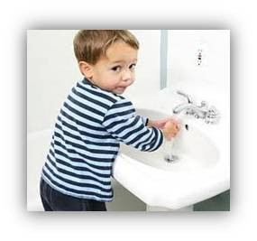
Wash
Key word
Wash your hands before eat.
Meaning
(Click here)
Clean
Notes:
First, the word can be shown. The SS can be asked to pronounce the word. If it is needed teacher can help. Then the picture can be shown and asked to guess the meaning. For feedback click on meaning button.

Slide 11
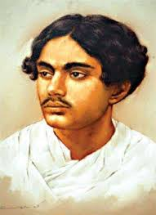
Favourite
Key word
Kazi Nazrul Islam is my favourite poet.
Meaning
(Click here)
Choice
Notes:
First, the word can be shown. The SS can be asked to pronounce the word. If it is needed teacher can help. Then the picture can be shown and asked to guess the meaning. For feedback click on meaning button.

Slide 12
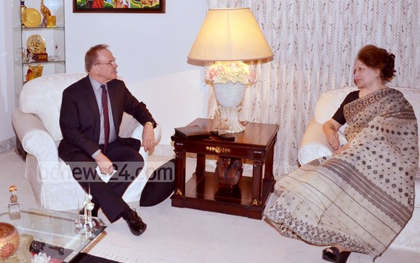
Living room
Key word
They are talking in the living room.
Meaning
(Click here)
A room for sitting.
Notes:
First, the word can be shown. The SS can be asked to pronounce the word. If it is needed teacher can help. Then the picture can be shown and asked to guess the meaning. For feedback click on meaning button.

Slide 13
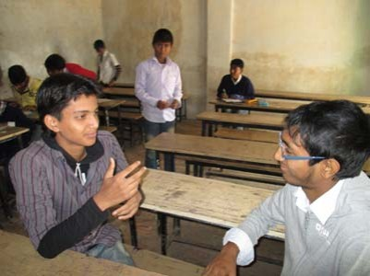
Pair works
Follow the conversation then practice in pair.
Dear Saad, What is your favourite food?
Where do you usually have it?
Who prepares it ?
How does it taste ?
Thanks, My favourite food is moragpolau.
Thank you.
I usually have it at home.
My sister prepares it.
It taste awesome.
You are welcome.
Now make pair and practise it.
Notes:
Students can write the answer on black or white board.

Slide 14
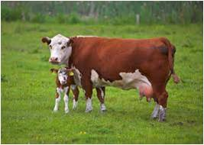
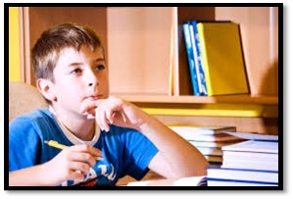
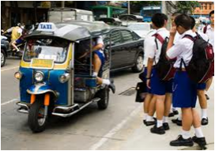
Grammar Focus
Present Indefinite tense :
When we express a habitual action, general truths, near future and narrate some thing, it`s called
Present Indefinite Tense.
The sun rises in the east.
The cow gives us milk.
They go to school everyday.
I read in class six.
Notes:
At first teacher may discuss about grammar focus then will give the task. For slide no. 15, 16 and 17.

Slide 15
Structure of Present Indefinite Tense.
Affirmative : Sub + present form of main verb + obj/ext.
Negative : Sub +do not / does not + present form of main verb + obj/ect.
Interrogative : Do / Does + Sub + present form of main verb + obj/ext ?
If subject is 3rd person singular number then s/es will be add with main verb.

Slide 16
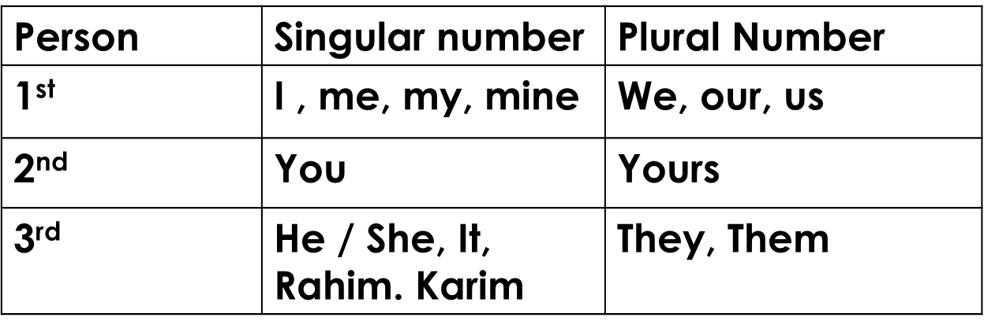
Person
By whom work is done, is called subject or person.
There are three kinds of person.

Slide 17
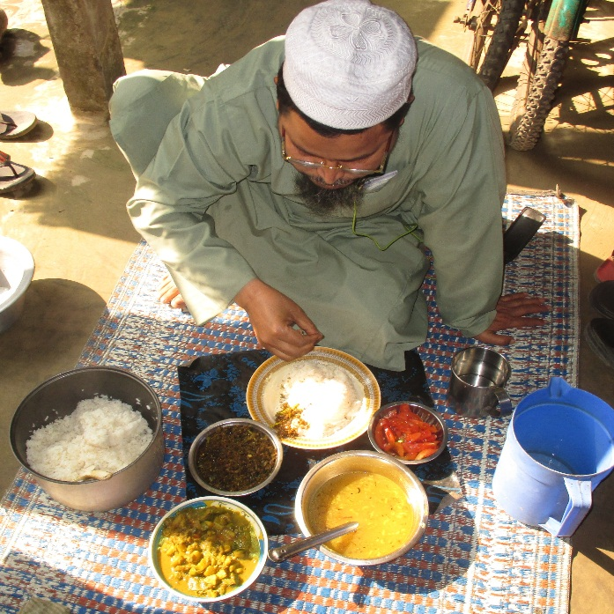
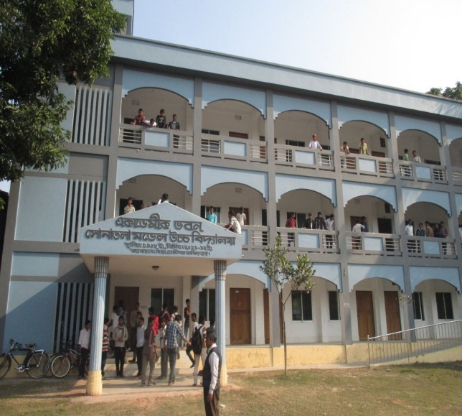
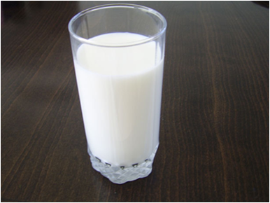
Individual /Pair Work
Look at the pictures and make five sentences using present indefinite tense. One is done for you.
I read is this school.
Notes:
Teacher can try to elicit the answer from students then he/she can give feedback.

Slide 18
Individual/Pair Work.
Now go to section A3. Fill in the blanks in the following sentences with the words in the box.
Using the rules of present indefinite tense.
Smell | See | Look | Know | Like | want
know
I ----------------------- him very well.
The new dress -------------------- great !
Rina ------------------ to collect stamps.
I can ------------------ a butterfly near the flower.
The flower -------------------------- sweet.
Murad -------------------- to buy a dictionary.
looks
likes
see
smells
wants
solution
a
b
c
d
e
f
Notes:
Teacher can try to elicit the answer from students then he/she can give feedback by clicking on solution button a,b,c,d,e & f.

Slide 19
Home work
Go to section A4, read the passage and choose which verb is better. Underline the word you choose. It`s your home work.
Notes:
Teacher can give some instructions to do the home work.

Slide 20
Acknowledgement
We would like to express our cordial gratitude to the Ministry of Education, Directorate of Secondary & Higher Education, NCTB, a2i
and
the panel of honorable editors ( Md. Jahangir Hasan, Associate Professor (English) TTC, Rangpur, Ranjit Poddar, Associate Professor (English) TTC, Dhaka, and Urmila Ahmed, Associate Professor (English) TTC, Dhaka, to enrich the contents.

Slide 21
THE END
Notes:
Teacher can say goodbye.

